Slide 1
Machine Learning for Predicting Migration
Useful for capturing nonlinear relationships and interactions between variables
Helps us in identifying variables most important for predicting migration using several specifications, instead of the “effects” of those variables
Explicitly allows for bias by making the model very rich, works best with a large number of predictors
Doesn’t give us a parametric model but tells us which variables could be included in one
No assumptions about the data generating process required to ensure consistency as both predictions 𝑦 ̂ and outcomes 𝑦 are observed (training/testing data)

Slide 2
Example: Revisiting forced migration: A machine learning perspective (EJPE, 2021)
Machine learning to predict forced migration
Data: Panel data from 45 African countries for the years 1997–2017
Method: Random Forests + LASSO for variable importance
Random Forests: Builds multiple decision trees on a bootstrapped sample of observations
Each decision tree is optimized to find observations that are homogeneous with respect to the outcome variable given a set of predictors
The random forest is the average of the resulting trees
A random sample of predictors is taken at each split to avoid averaging highly correlated trees

Slide 3
Example: How to model the weather-migration link: a machine-learning approach to variable selection in the Mexico-U.S. context (Journal of Ethnic and Migration Studies, 2023)
Machine learning to predict migration using weather variables
Data: Mexican Migration Project (130,000 people, 1980-2016)
Method: Random Forests + k-fold cross-validation for estimation
Classification of individuals as migrants or non-migrants using 36 weather variables
More complex models may not generalize well to the validation or test data, so they use a regularizer to decide depth of trees
Fixed ratio of 1:10 between migrants and non-migrants in test and training (random draw of individuals without replacement)
Penalize false negatives (classified as “no migration” but person migrated) more than false positives using weights

Slide 4
Our Set Up
75-25 split, training: N=164539, testing: N=51913
Randomization at individual level, so same individual at different points in time doesn't end up in both training and test datasets
Dep. variable: work_us (whether or not worked in the US in year t)
Predictors: male, age, hhchildren, hhworkforce, ag, nonag, year dummies, village dummies, yrs_worked_in_mx_cum (no. of years worked in Mexico till year t)
work_us = 1 in only 6% of observations (highly imbalanced classes)

Slide 5
Year | Freq. | Percent | Year | Freq. | Percent
1980 | 5,222 | 2.41 | 1995 | 7,733 | 3.57
1981 | 5,222 | 2.41 | 1996 | 7,733 | 3.57
1982 | 5,222 | 2.41 | 1997 | 7,733 | 3.57
1983 | 5,222 | 2.41 | 1998 | 7,733 | 3.57
1984 | 5,222 | 2.41 | 1999 | 7,733 | 3.57
1985 | 5,222 | 2.41 | 2000 | 7,733 | 3.57
1986 | 5,222 | 2.41 | 2001 | 7,733 | 3.57
1987 | 5,222 | 2.41 | 2002 | 7,733 | 3.57
1988 | 5,222 | 2.41 | 2003 | 9,156 | 4.23
1989 | 5,222 | 2.41 | 2004 | 9,151 | 4.23
1990 | 7,733 | 3.57 | 2005 | 9,147 | 4.23
1991 | 7,733 | 3.57 | 2006 | 9,140 | 4.22
1992 | 7,733 | 3.57 | 2007 | 9,133 | 4.22
1993 | 7,733 | 3.57 | 2008 | 5,994 | 2.77
1994 | 7,733 | 3.57 | 2009 | 5,991 | 2.77
1995 | 7,733 | 3.57 | 2010 | 5,991 | 2.77

Slide 6
Year | % work_us | Year | % work_us
1980 | 1.63 | 1995 | 5.87
1981 | 1.70 | 1996 | 6.06
1982 | 1.91 | 1997 | 6.62
1983 | 1.99 | 1998 | 7.13
1984 | 1.95 | 1999 | 8.17
1985 | 2.32 | 2000 | 9.18
1986 | 2.59 | 2001 | 9.58
1987 | 2.87 | 2002 | 10.54
1988 | 3.10 | 2003 | 7.83
1989 | 3.06 | 2004 | 8.50
1990 | 4.29 | 2005 | 8.95
1991 | 4.20 | 2006 | 9.39
1992 | 4.86 | 2007 | 9.78
1993 | 5.11 | 2008 | 6.28
1994 | 5.42 | 2009 | 5.96
1995 | 5.87 | 2010 | 5.74

Slide 7
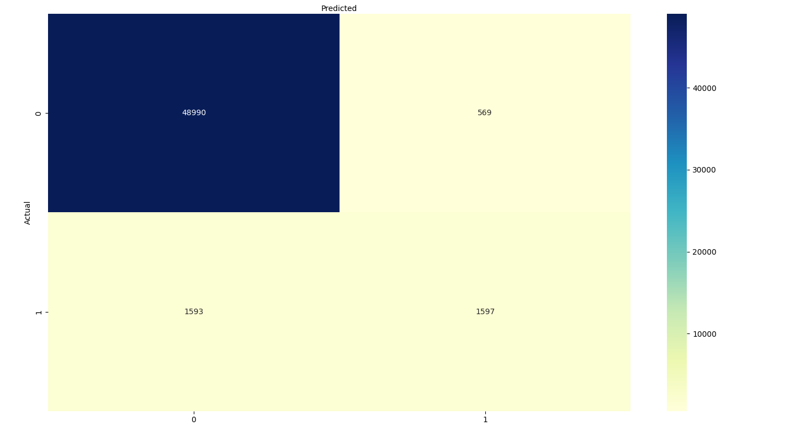
Simple Logistic Regression Model Results

Slide 8
Simple Logistic Regression Model Results
Overall accuracy: 96%
Correctly predicts if an individual DIDN'T work in the US in year t 99% of the time
Correctly predicts if an individual DID work in the US in year t only 50% of the time (i.e., coin toss)
Gives us coefficients but a linear model doesn’t allow for nonlinear relationships and interactions
Need to account for large imbalance between classes, oversampling minority class (SMOTE) does not improve results

Slide 9
Dealing with Imbalanced Classification
SMOTE: Over-sampling technique that generates synthetic samples for the minority class (i.e. observations where migration=1 in our sample)
Gradient boosting: Combines multiple weak models to create a strong predictive model, uses decision trees like random forests but it iteratively corrects errors, so the trees aren’t independent. Allows assigning different weights to classes
... to be continued

Slide 10
Gradient Boosting Model + SMOTE
Gradient boosting model requires specifying hyperparameters
I do “hyperparameter tuning” to choose the best performing parameters from a set of options: {'learning_rate': 0.1, 'max_depth': 3, 'n_estimators': 50}
I combine this model with SMOTE
Accuracy for migration=1: 83% (from 50% earlier)
Accuracy for migration=0: 89% (from 99% earlier)
Performance improved for minority class but got worse for majority class

Slide 11
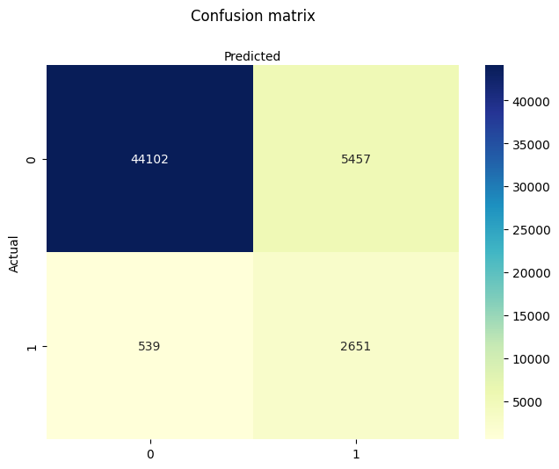
Gradient Boosting Model + SMOTE

Slide 12
Next Steps
Research question and motivation? Predicting whether individuals migrate in any given year or predicting who migrates at all in their lifetime?
Do we only care about variable importance? Do we stick to non-parametric models because they perform the best (even if they aren’t easily interpretable)?
Try new models and techniques including random forests with regularization, and other ways of adjusting for imbalanced classes
Find new data, especially new variables, ML is most useful when the number of predictors is high

